Slide 1
RRP District 2452 District Chairperson Awards Tutorial

Slide 2
Logging In
In order to log on to RRP (Rotary Resource Planning), you have to either:
Click on this link http://www.Rotaryd2452.org/erp or type it in your browser.
Enter your login email and password.
If you forgot your password or don’t know it click on forgot password.
A passwords reset link will be sent to your email.

Slide 3
You are automatically directed to your District Dashboard.
You can change your password anytime by pressing the Profile tab in the Upper Menu.
You are automatically directed to the District Dashboard.
Press on the Final Awards tab found on the left menu.

Slide 4
Searching for Awards
You can search for awards using the search box.
Type the word in the search box and press search.
Press clear to reset the search box.
The results of your search will be available in a list containing Award Title and Deadline.

Slide 5
Awards Grading
Click on the Reviews icon.
If no club posted their awards no reviews will appear.

Slide 6
If a club posted their awards, you will see the Club Name, Review Date, and Action icons (Review, Grading).
Press the Reviews icon to view and download the review file the Club Beirut Metropolitan posted in 14/01/2014.

Slide 7
If the AG posted his comments on the awards, you will see the Post icon in the Action Tab.
Press the Reviews icon to view and comment on the review file the Club Beirut Metropolitan posted in 14/01/2014 and the AG comments.

Slide 8
Press on the attached file name (Document, Image, Audio, Video) posted by the Club to download it on your device.
Press on the Review Details Tab to view the comments posted by the AG on the Club Awards.

Slide 9
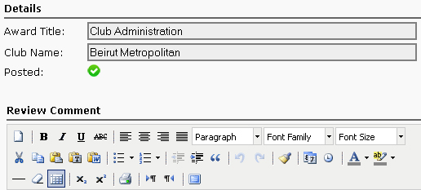
If the AG posted his comments you will see a green check mark besides Posted, otherwise a red cross.

Slide 10
Click on the Grading icon to start grading the Club Review.
Fill the score of each question and make sure to save your grading by pressing Save & Close.

Slide 11
You can edit the scores by pressing the the Grading icon as long as the grades have not been posted.
To post the grades press the Post icon.
After posting the Grades you can only see the Grades and Comments without the ability to edit them.
Repeat the process for each Club review.
The work of the Chairperson is complete.

